Slide 1
Natural Language Processing
Lab -1
Introduction to NLP + Python Revision

Slide 2
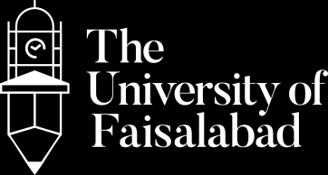



www.tuf.edu.pk
unioffaisalabad
Name: Rimsha Rasheed Alvi Program: Software Engineer Experience: Lecturer + Web Developer
For contact: rimsharasheed.CS@tuf.edu.pk

Slide 3
www.tuf.edu.pk
unioffaisalabad
Objectives:
Understand what NLP is and its real-life applications.
Revise Python basics: variables, operators, control structures, loops, and functions.
Write simple Python programs as a foundation for future NLP tasks.

Slide 4
www.tuf.edu.pk
unioffaisalabad
Code Editor
Google colab
Jupyter
Anaconda
Thony

Slide 5
www.tuf.edu.pk
unioffaisalabad
Introduction to NLP:
Natural Language Processing (NLP) is a branch of Artificial Intelligence (AI) that helps computers understand, interpret, and generate human language.
Examples:
Chatbots (e.g., ChatGPT)
Google Translate
Sentiment Analysis (positive/negative reviews)
Speech-to-Text systems

Slide 6
www.tuf.edu.pk
unioffaisalabad
Applications of NLP:
Text Classification (Spam detection, News categorization)
Machine Translation (English to French)
Speech Recognition (Siri, Alexa)
Information Extraction (Extracting phone numbers, emails)

Slide 7
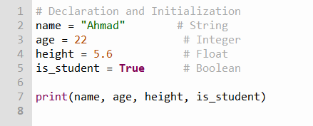
www.tuf.edu.pk
unioffaisalabad
Python Revision:
Variables and Data Types:

Slide 8
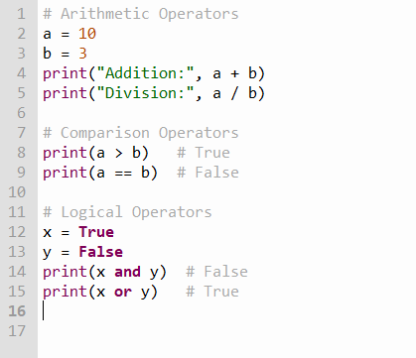
www.tuf.edu.pk
unioffaisalabad
Python Revision:
b) Operators:

Slide 9
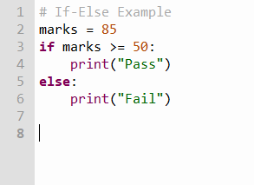
www.tuf.edu.pk
unioffaisalabad
Python Revision:
c) Control Structures:

Slide 10
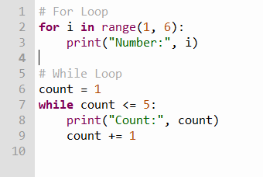
www.tuf.edu.pk
unioffaisalabad
Python Revision:
d) Loops:

Slide 11
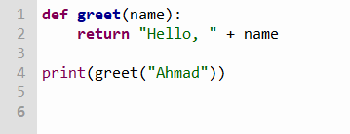
www.tuf.edu.pk
unioffaisalabad
Python Revision:
e) Functions:

Slide 12
www.tuf.edu.pk
unioffaisalabad
Tasks:
Write a program to check if a number is even or odd.
Write a function that takes a string and returns it in uppercase.
Print the first 10 natural numbers using a loop.
Write a program to find the largest of three numbers.
Write a program to swap two numbers without using a third variable
Take two numbers from the user and print their sum, difference, product, and quotient.
Write a program that checks if a year is a leap year or not.

Slide 13
www.tuf.edu.pk
unioffaisalabad
Tasks:
Print the multiplication table of any number entered by the user.
Write a program to remove duplicates from a list.

Slide 14
THANK YOU

